Slide 1
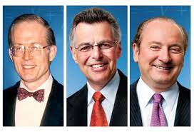
Black- Scholes - Merton model
Leon Eshuijs
Pietro Bicocchi
Forozan Faghiri
Final project NM December 2022

Slide 2
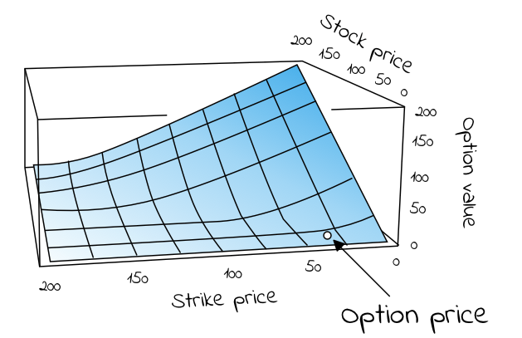
Overview
What are options?
The Black-Scholes: PDE
Analytical Solution
Numerical Solution:
Explicit
Implicit
Results and comparison
Conclusion
Notes:
Note from leon: reduce content if necesarry

Slide 3


What are options?
Example: 100 stocks of Apple
Expiration time: 5 days
Current price: €10
Strike price: 11
If at expiration time:
Apple (stock) price: €13
Profit: 100 * (13-11) = €200
If price is less than strike price (€11)
No profit but also “No” loss
Less risky
Q: For how much should I buy the option from pietro on day 3?
( )

Slide 4
What are options?
Option Types:
Call option: I think the price of the stock it is going up
Put option: I think the price of the stock is going down
Option style:
European :
Can only exercise option on the expiration date
American :
Can exercise the option anytime up till expiration date

Slide 5
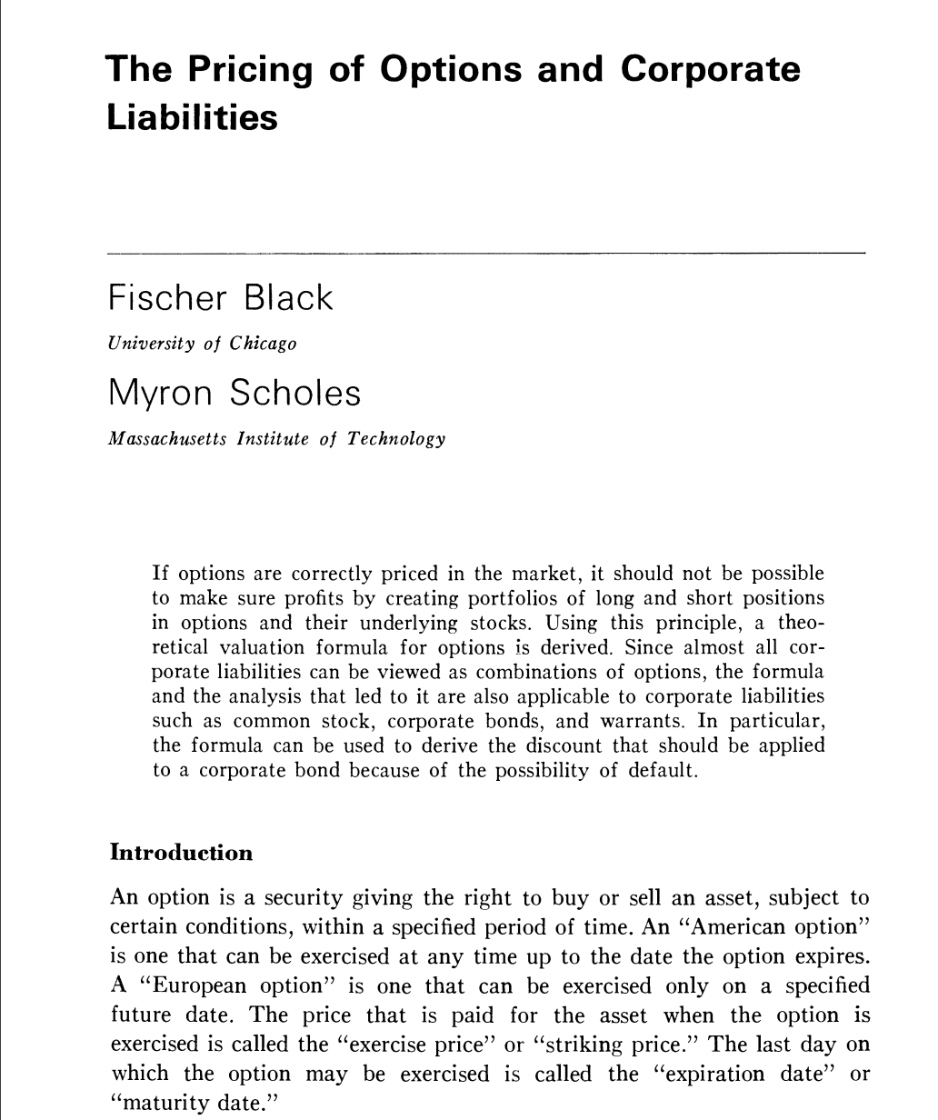
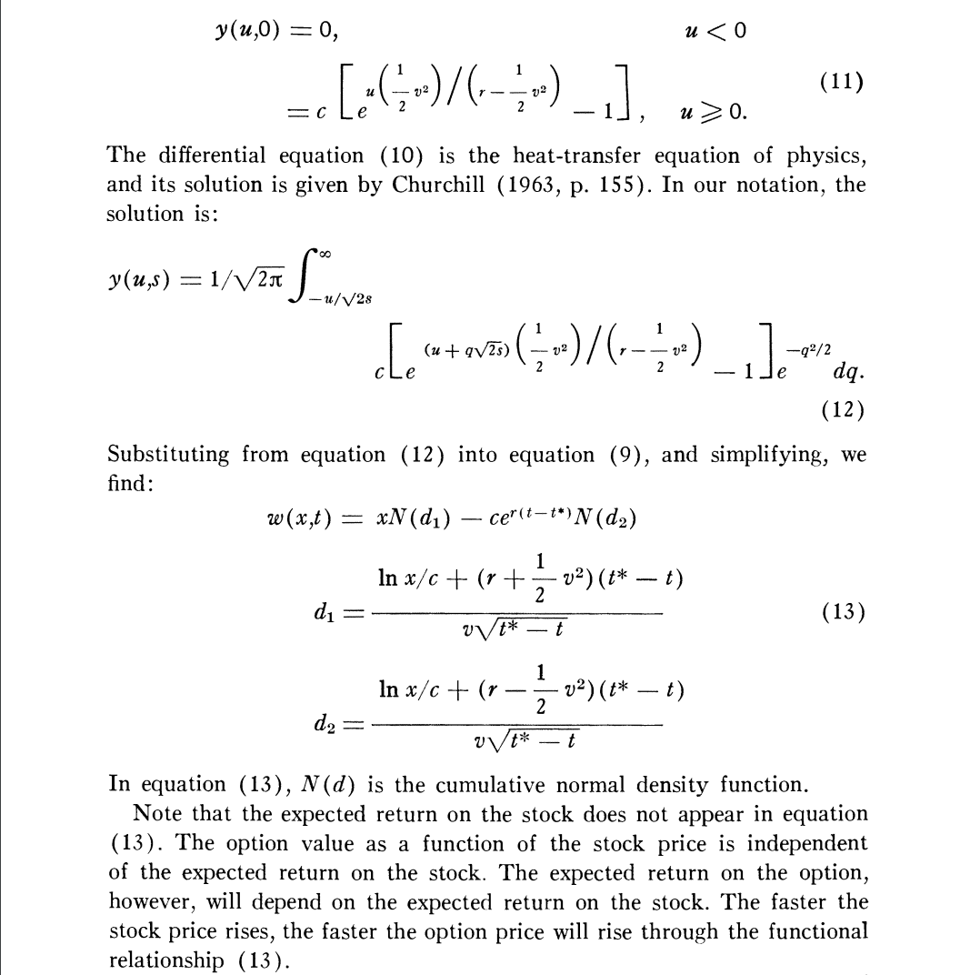
Q: What is the price of an option in time?
Black Scholes model
The Pricing of Options and Corporate Liabilities Author(s): Fischer Black and Myron Scholes Source: The Journal of Political Economy, Vol. 81, No. 3 (May - Jun., 1973), pp. 637-654

Slide 6
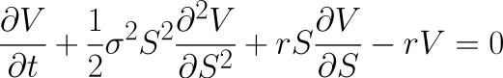
Black–Scholes model
The Black–Scholes model is a mathematical model simulating the dynamics of a financial market containing derivative financial instruments such as options. The model is based on a partial differential equation (PDE), the so-called Black-Scholes equation, from which one can deduce the Black-Scholes formula, which gives a theoretical estimate of the correct price of European stock options.

Slide 7
Black–Scholes model
Assumptions
1) Interest rate is known and constant through time.
2) The stock follows a random walk in continuous time, the variance of the stock price paths follow a log-normal distribution.
3) Volatility is constant.
4) Stock pays no dividends (can be modified to include them however)
5) The option can only be exercised at expiration i.e. it is a European type option.
6) No transaction costs i.e. fees on shorting selling etc.
7) Fractional trading is possible i.e. we can buy/sell 0.x of any given stock.

Slide 8
Black-Scholes model: PDE
V(S,t) price of the option as a function of S and t
Parameters:
T expiration time*
t the current time step
r risk-free interest rate*
𝞂 stock volatility*
K exercise price*
S stock value

Slide 9
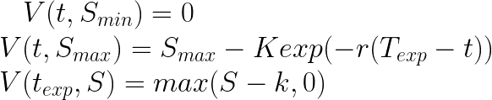
Black-Scholes: Boundary Conditions
Boundary conditions:

Slide 10
Black–Scholes model
Summarizing:
What we are interested in? Option pricing
What type of option? European Call option ⇑ Bullish market
When I can exercise the option? (European option) At the expiration time, if it's convenient.
What model do I use to price the option in the meanwhile? Black-Scholes model
Why do I need to price the option in the meanwhile? It helps to develope risk-free strategies → buying the underlying asset ≡ Hedging

Slide 11

Black-Scholes Model: Solutions
Analytical vs Numerical solutions
Analytical: ∃ an analytical solution.
Numerical: we aim to integrate the PDE numerically using different techniques.

Slide 12
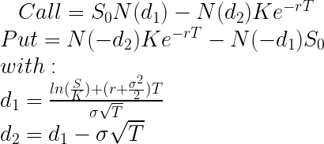
Analytical solution
The analytical solution of this model is called the Black-Scholes-Merton option pricing formula. It is long, ugly, and confusing. It doesn’t even give an intuition for pricing options. The derivation of it is so difficult that Scholes and Merton received a Nobel prize for it in 1997 (Black died in 1995). It relies on the Feynman-Kac theorem and risk-neutral measures, but I will not get into it.
Solution for both the put and the call is given below:

Slide 13
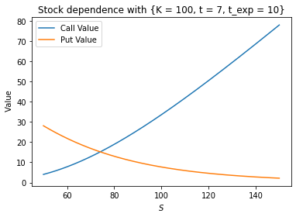
Analytical solution: stock dependence
t, sigma fixed
call option
S ⇑ V ⇑
S ⇓ V ⇓
put option
S ⇑ V ⇓
S ⇓ V ⇑

Slide 14
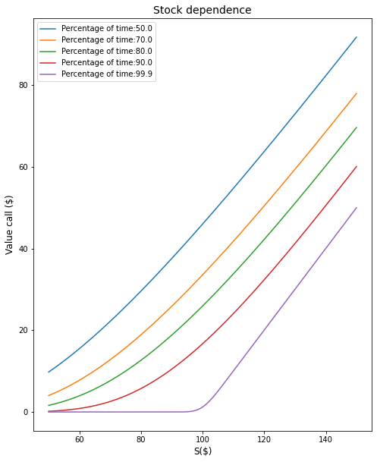

Slide 15
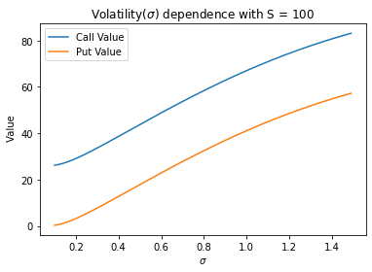
Analytical solution: volatility dependence
t, S is fixed
call, put option
sigma ⇑ V ⇑
sigma ⇓ V ⇓

Slide 16
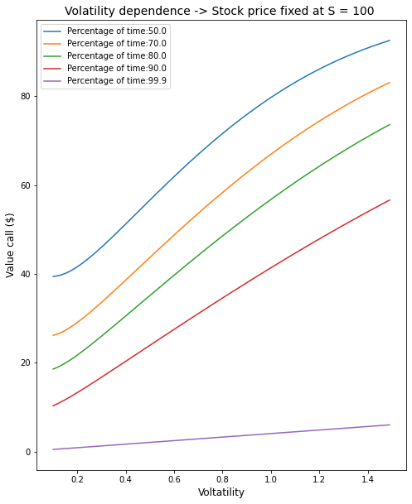

Slide 17
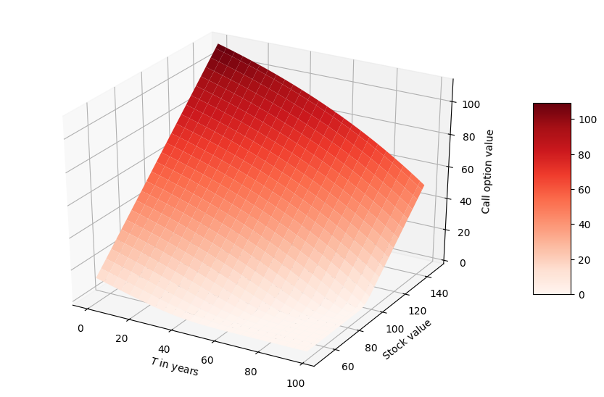
Call option

Slide 18
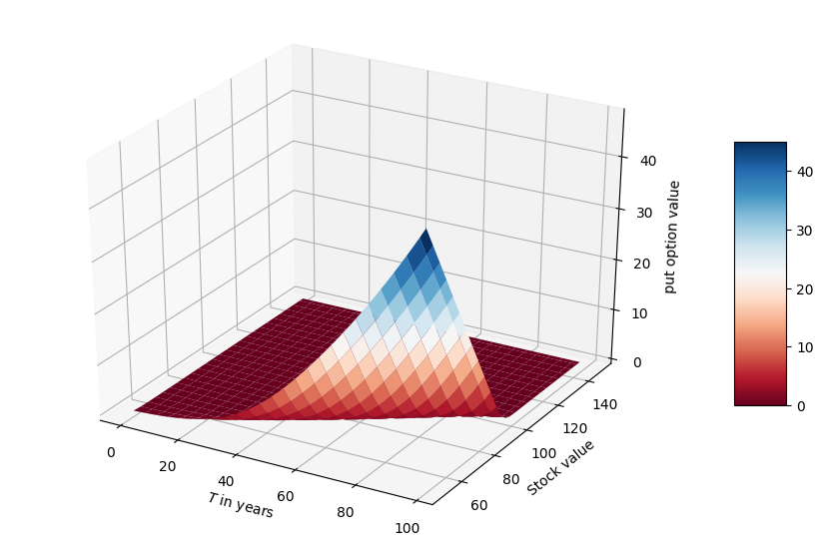
Put option

Slide 19
Numerical solutions
explicit method
implicit method

Slide 20
Explicit finite difference method
Grid
Boundary conditions
Derivative estimation - Discretization
Building the solver (Explicit)
Notes:
Theoretical solution $V_{real}$ of Black-Scholes equation is defined on the continuous space. In contrast, the approximation solution $V_{approx}$ derived from the discretization of the equation is only defined for the nodes.

Slide 21
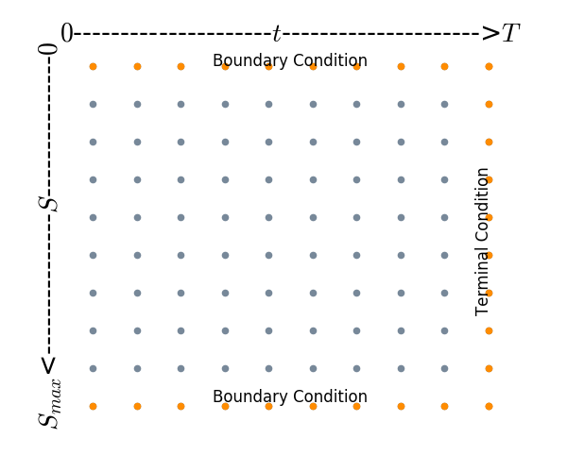
Explicit finite difference method: the grid
Notes:
At first is necessary to set up a **grid of points**.
This grid will be used to integrate the PDE from point to point. The grid on the x-axis will represent the discretized times, which ranges from $[0,10]$ and the y-axis will represent the possible stock prices, ranging from $[S_{min},S_{max}]$ .
Our goal is to determine the option price above each point on the grid.

Slide 22
Boundary conditions
Since in our boundary conditions we have the last boundary of the grid, we simulate the equation backward
Notes:
>The **bottom** is the easiest, we will set $S_{min}=0$ .
>The top condition is a bit more tricky. We choose it to be well above the option’s strike price K to ensure the option’s value $V = max( S-K, 0)$ will always (with negligible probability of not happening $p < 0.0001$) payout $S-K$. We can do this by setting $S_{max}$ 8 standard deviations away from the mean, as the stock price is log-normally distributed. So, if we take $S_{max}=8 sigma(T-t)^{0.5}$ , we have ensured that property.
> The option value V at $S_{max}$ can be deducted using a replication argument. If a derivative pays $S-K$ at time t, we can replicate it by purchasing 1 unit of stock and putting $e^{(-r(1-t)}K$ it into a risk-free bank account. So this makes the value of the option for large S: $V(t,S_{max})= S_{max} — e^{(-r(1-t)}K $.

Slide 23
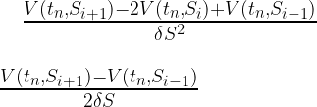
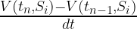
Derivative estimation
Central difference estimates for S derivatives
Central difference for a first order derivative (Δ) is a second order method O(δS^2)
Central difference for the second order derivative (Γ) is a second order method O(δS^2)
Backward difference for time derivatives
First order method in time

Slide 24
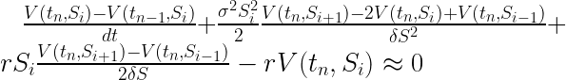
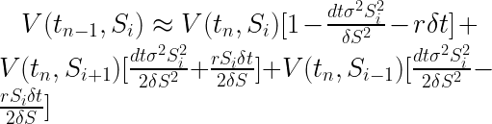
Building the solver
Plugging these into B-S:
Isolating V(t_{n-1},S_i)

Slide 25
Building the solver
Recasting it as:
This is a system of ODEs, where V is the column vector of option prices at each timestep.
By iterating the above process we can simulate the above grid by going one step at a time. Note, that as we know the final boundary condition and not the first, we will be actually be going back in time.

Slide 26
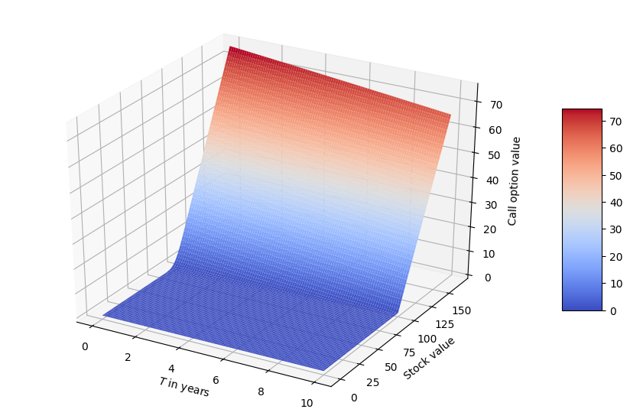

Slide 27
Finite Difference
Implicit Method
Backward difference in time
Centered difference in Position

Slide 28
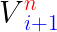
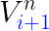
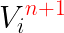
Discretization difference between the two models
Discretization of Implicit Method
Discretization of Explicit Method

Slide 29
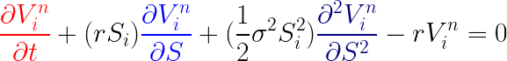
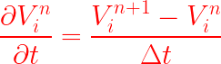
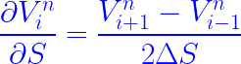
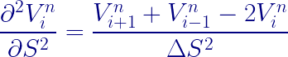
Derivative Estimation
Black Scholes Equation =>
Backward difference (t) =>
Centered difference (S) =>
(first order)
Centered difference (S) =>
(Second order)

Slide 30
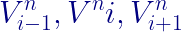
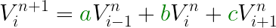
Reshaping to build a solver
Black Scholes Equation (PDE) Backward (t) and Centered (S)
Reorder in terms based on

Slide 31
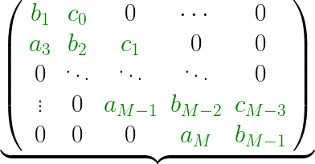
Coefficients of
Discretization of Implicit Method

Slide 32
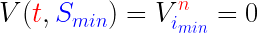
Boundary Conditions

Slide 33
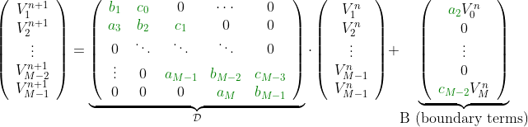
Matrix and Boundary terms
Number of time step = M
Construction of the Matrix D + Boundary terms

Slide 34
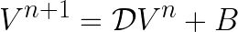
Inverting Matrix for implicit Method

Slide 35
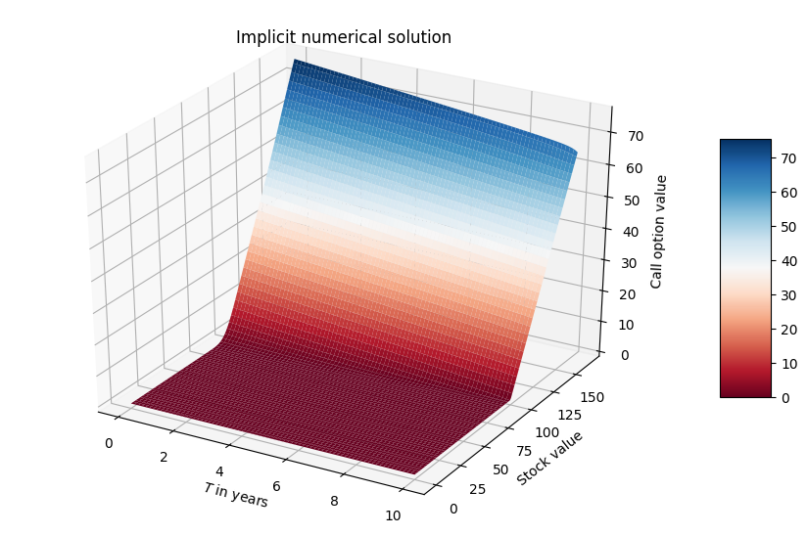
Finite Difference Method (Implicit)

Slide 36

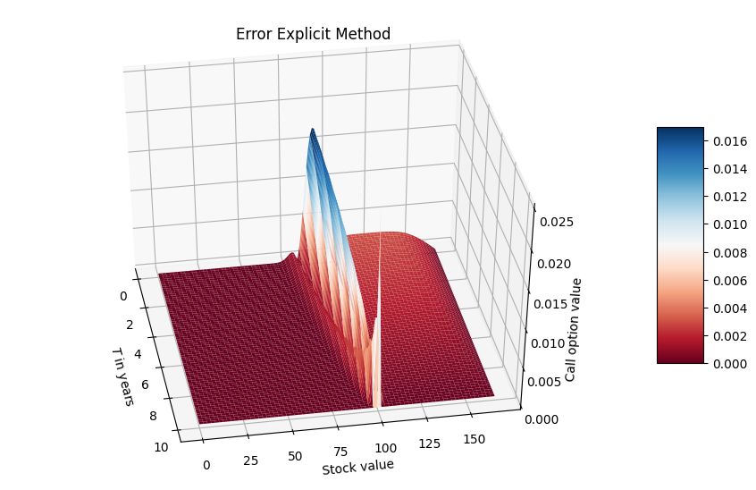
Results: Explicit solver
Difference analytical solution
Using 256 steps in Stock and Time
Backward in time
Notes:
For myself:
Explicit:
Backward in time
Centered in space
Implicit:
Forward in time?
Centered in space

Slide 37

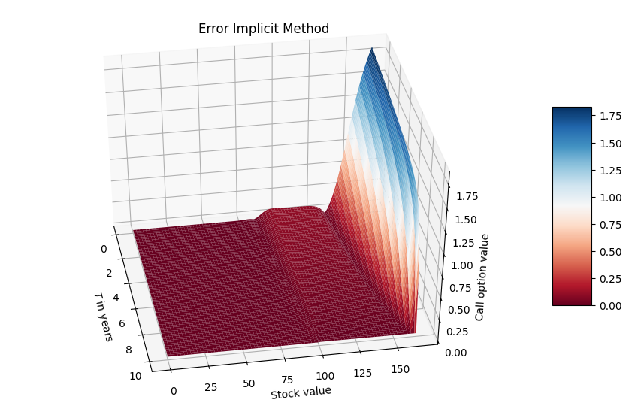
Results: Implicit solver
Using 256 steps in Stock and Time
Backward in time
Boundary issues?
Notes:
For myself:
Explicit:
Backward in time
Centered in space
Implicit:
Forward in time?
Centered in space

Slide 38
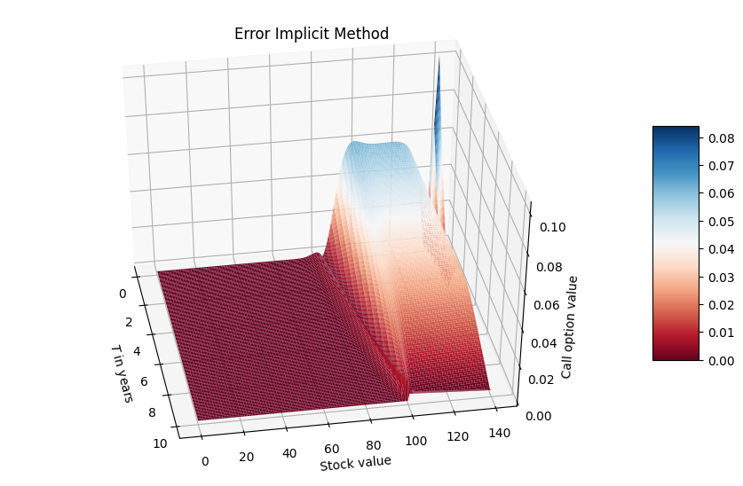
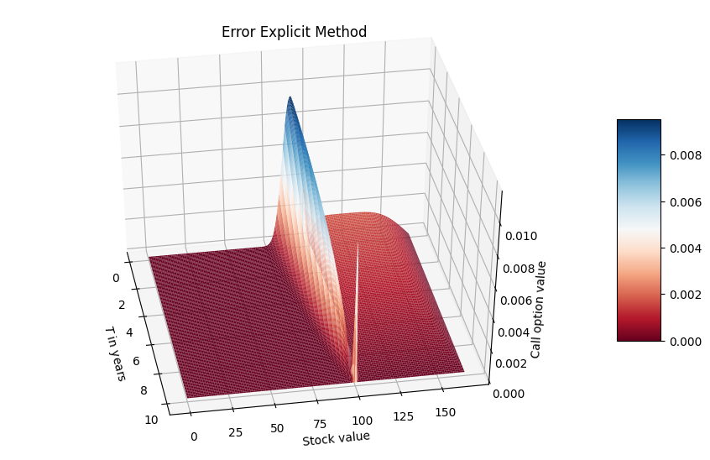
Comparison: error direction
Cut off after Stock at value 140/156
Notes:
For myself:
Explicit:
Backward in time
Centered in space
Implicit:
Forward in time?
Centered in space

Slide 39
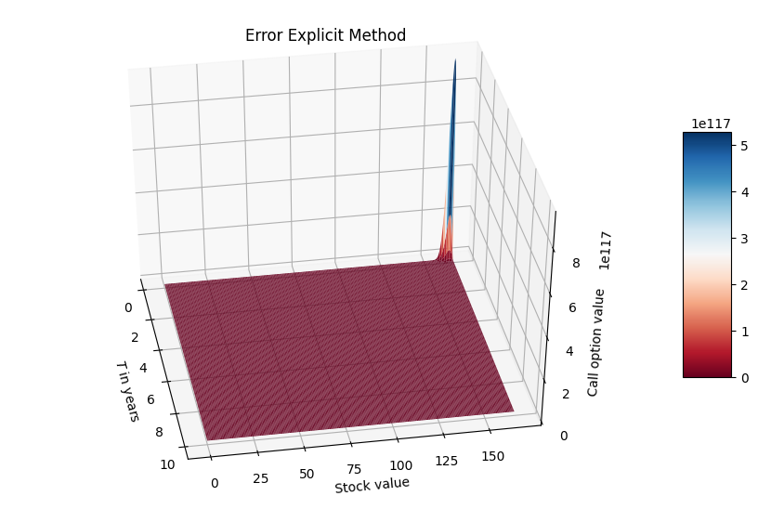
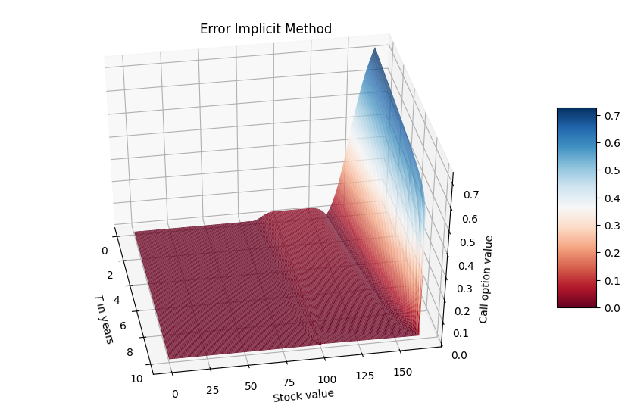
Comparison
Stability: if dS and dt are 400?
Time:
The explicit took: 0.220 ms
The implicit took: 0.601 ms
The Analytical solution took: 13.386 s
Notes:
The explicit took: 0.0002200
The implicit took: 0.0006008
The Analytical solution took: 13.3856

Slide 40
Conclusion
Black, Scholes and merton, got nobel price in 1997
All famous banks use it.
In line with theory
Explicit:
Faster
More specific short time
Implicit:
More stable over longer steps

